Slide 1
Covid-19 Image Dataset 3 Way Classification
Abulaiti Akeli
Deqing Liang
Yingpeng Ma

Slide 2
Project Description
Background
This is a project from Kaggle website (Covid-19 Image Dataset | Kaggle)
The original goal of this project is to help Deep Learning and AI Enthusiasts to improve COVID-19 detection using Chest X-rays, which would help the medical and research community and encourage them to contribute extensively on COVID-19 studies
Our Responsibility
This project aims to build a 3 way classification model to classify X-ray images of COVID-19, Viral Pneumonia and normal chest
Basically Speaking, our task is to use different types of machine learning or deep learning algorithms to train and test out which chest x-ray images are COVID-19, normal, or Viral Pneumonia, with limited data provided by the publisher

Slide 3
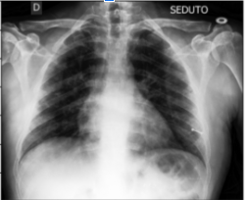
About Our Dataset
The data set contains 317 cleaned lungs’ X-ray images in total, which has already pre-divided into training and testing directories
Each of those directories branches into three different classes, such as Covid-19, Viral Pneumonia, and Normal
The training directory contains 251 images in total, 111 for COVID-19, 70 for normal and 70 for Viral Pneumonia.
The testing set on the other hand also includes 66 images in total, 26 for COVID-19 and 20 for Normal
and Viral Pneumonia each.

Slide 4
Developed Methods And Tools
Methods
Image Resize and Reshape
Random Shuffle
Scale Normalization
One Hot Encoding
Grid search
10 fold cross validation
ROC Curve and AUC
PCA
Confusion Matrix
Tools
Jupyter Notebook
Numpy
Open CV
OS
Scikit-learn
Tensorflow
Matplotlib

Slide 5
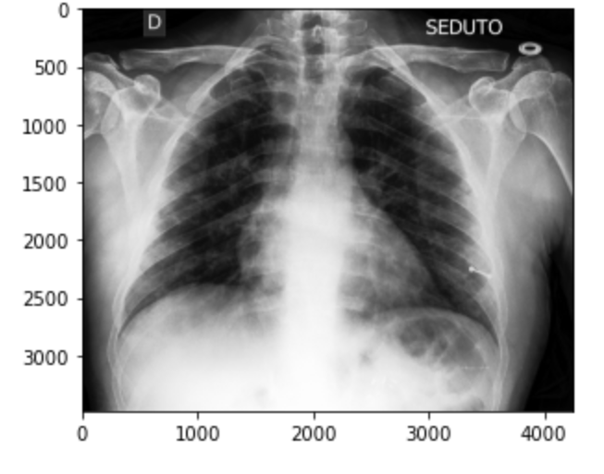
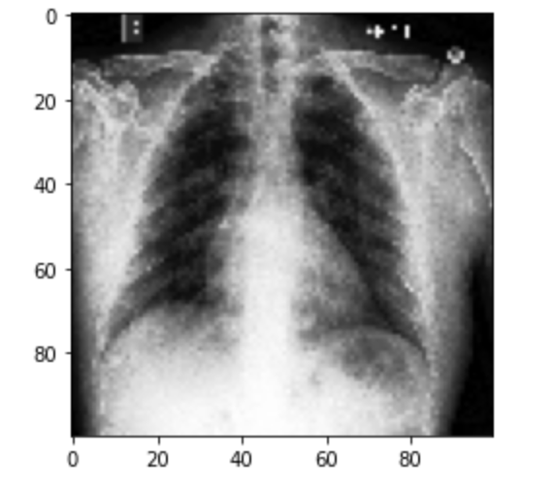
Data Cleaning & Data Pre-Processing
Before:
3400 X 4200 X 3
After:
100 X 100 X 1

Slide 6
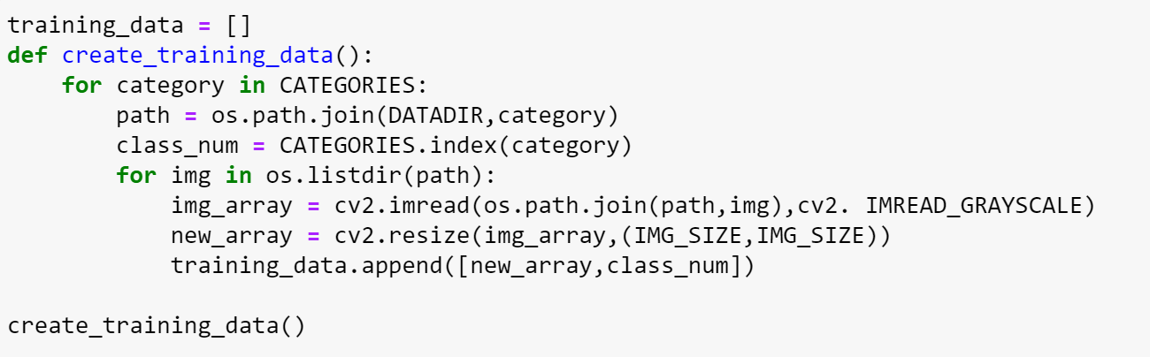

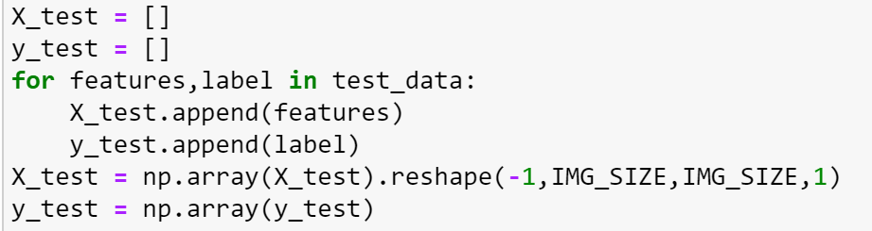
Data Cleaning & Data Pre-Processing
The first screen shot’s code is how we import the images and create the training dataset. It loops through every folder and images under the train directory one by one.
The purpose of the second screen shot is to implement the random shuffle method to mix up the images in the dataset for a better Machine Learning performance
The third one is the final tweak, separating the features and labels and turning them into np array. The image features also get reshape at this process. Some of our models will use these label sets.

Slide 7
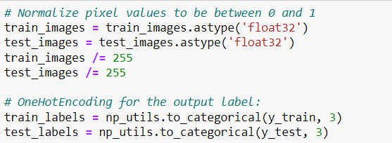
Data Cleaning & Data Pre-Processing(Cont.)
We simply normalize the features to the range of [0,1]
We perform One Hot Encoding for the label y. So, our label will be a vector of 3 elements for each data sample.

Slide 8
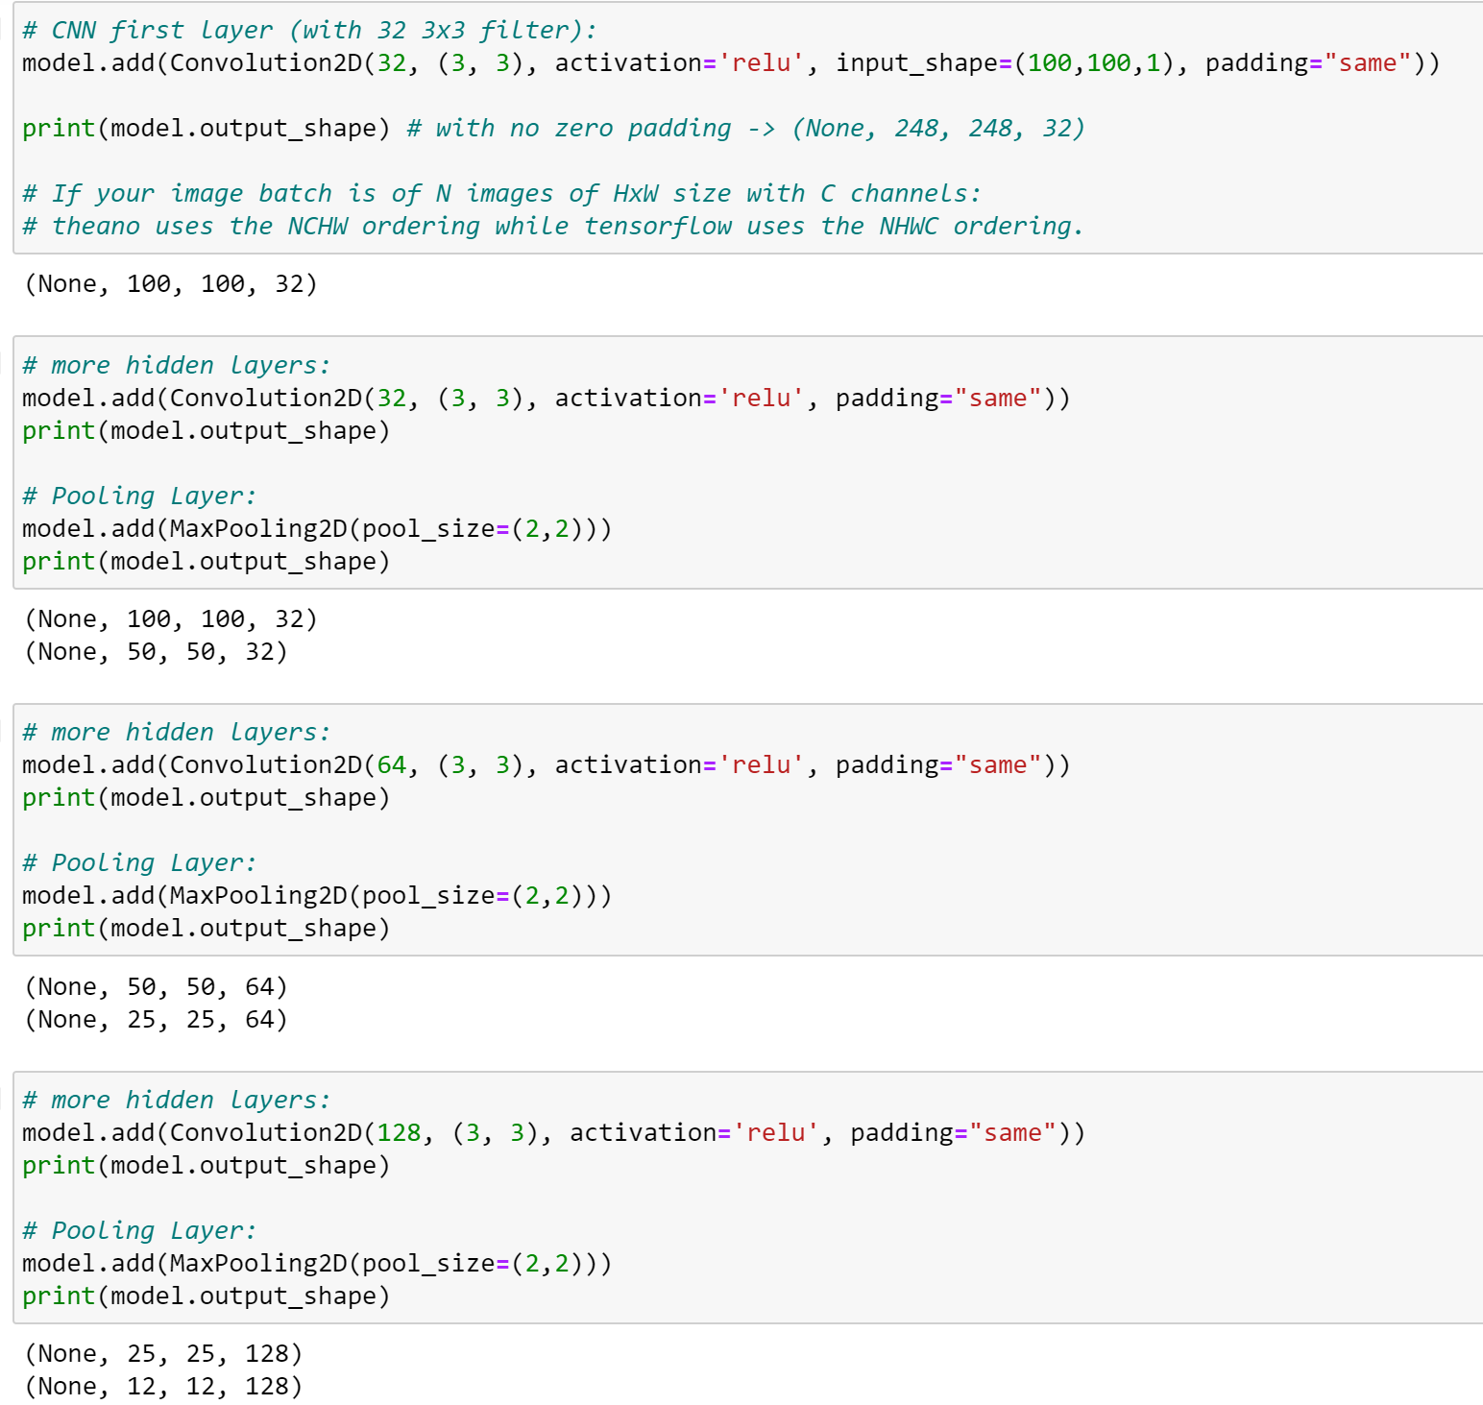
CNN(Convolutional Neural Network)
CNN takes the image’s raw pixel data without we reshape the feature values, trains the model, then extracts the features automatically for better classification.
Supposed to be one of the most power algorithm for image training, but maybe not the best in our case since our dataset is quite small.
Still quite a decent final result but we don’t see the potential to further improve the result.
The screenshot at the right shows the final structure of our CNN model, the convolutional layers and all the hidden and the maxpooling layers.

Slide 9
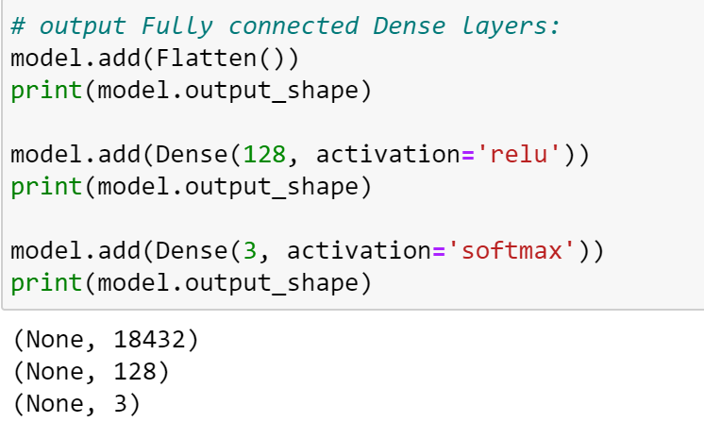
CNN(Convolutional Neural Network)
The right screenshot is the continuation of our CNN model structure, the fully connected layers.
Screenshot below shows the batch sizes and epochs we used for our training. We tried to implement grid-search to find the best results but it took abnormally long time for some reason, so we just manually tried out lots of different combinations.

Slide 10
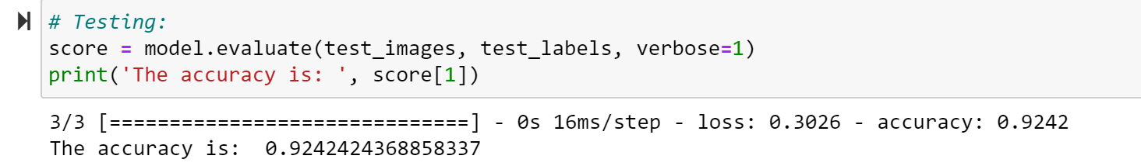
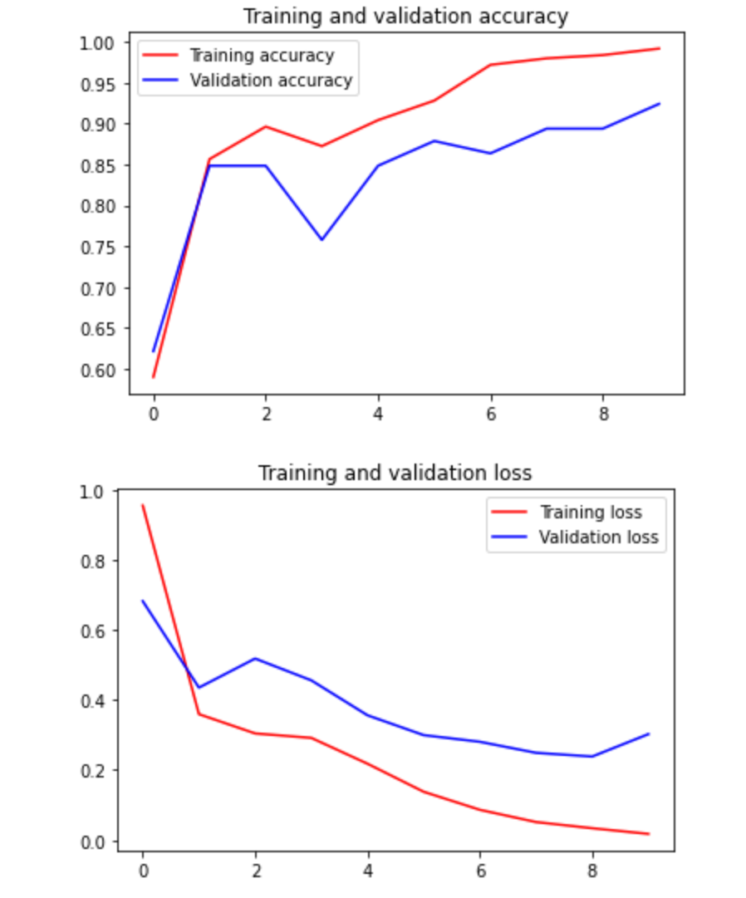
CNN(Convolutional Neural Network)
Final Result:

Slide 11
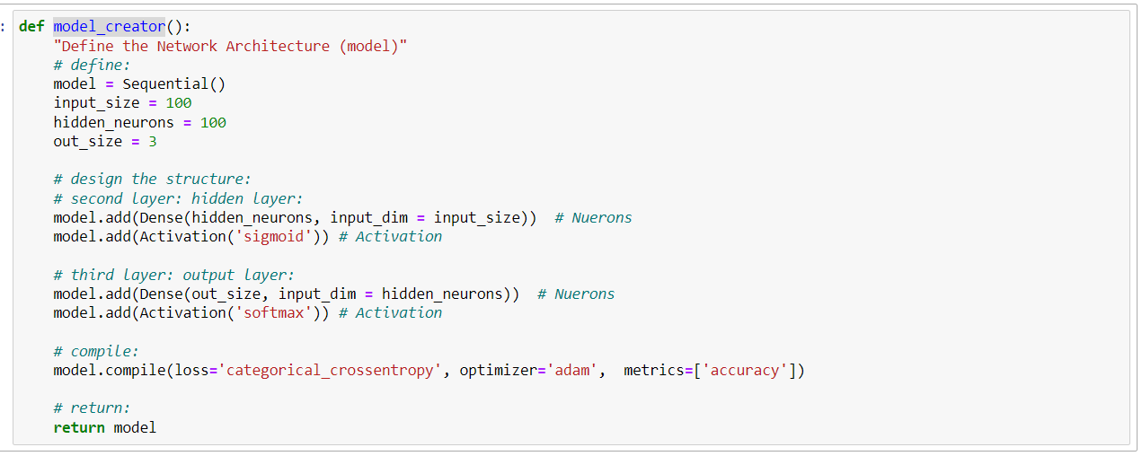
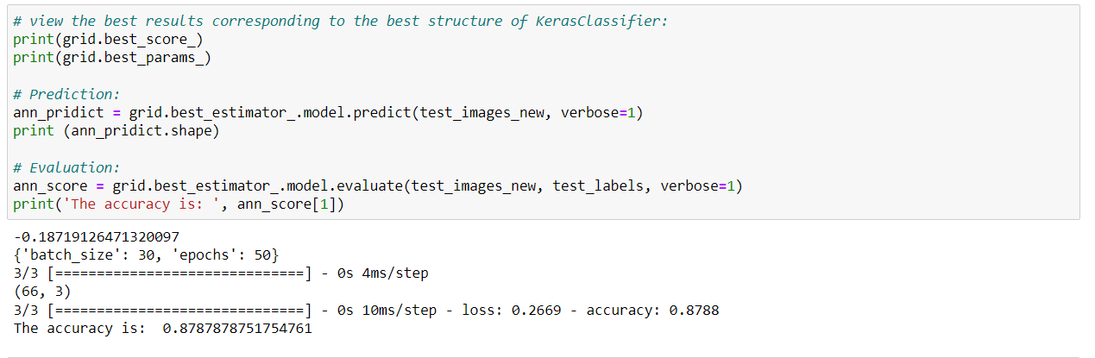
ANN(Tensorflow library)
With Tensorflow library, we define the model_creator function to build our ANN model just like what we did in the lab. In this function, we configure 100 input features, which is the same size after dimensionality reduction(PCA), 100 hidden_neurons and only output 3 features
Then, after brute force by grid search we found the best parameter is batch size: 30, epochs: 50, and the accuracy of this algorithm is around 0.8788

Slide 12
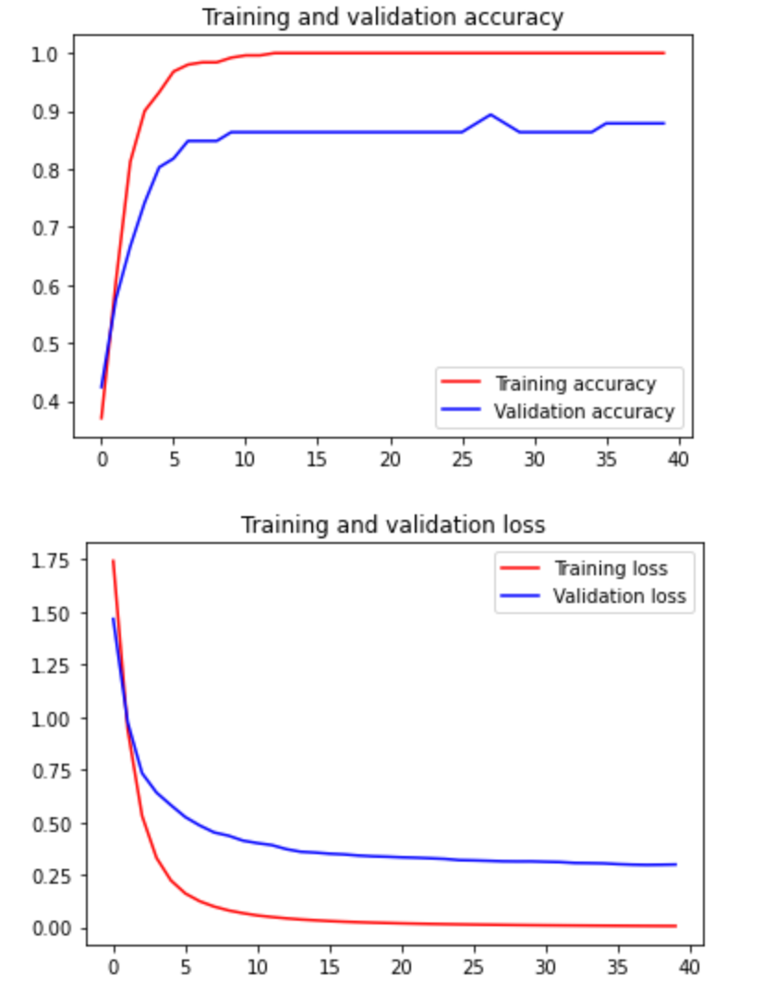
ANN(Tensorflow library)(Cont.)

Slide 13
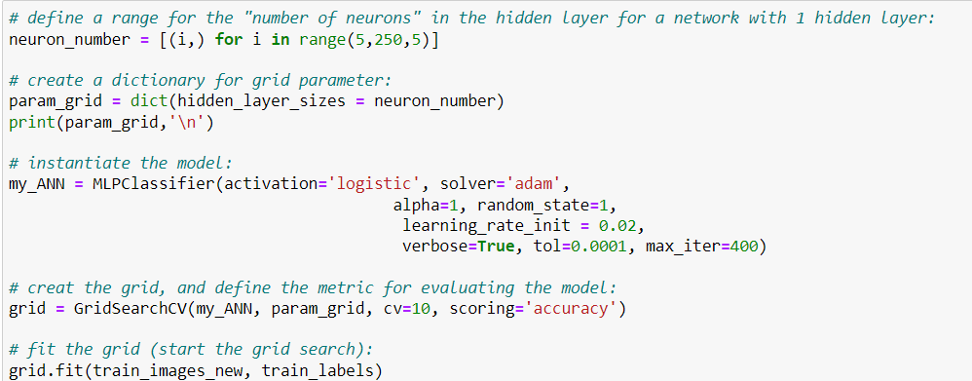
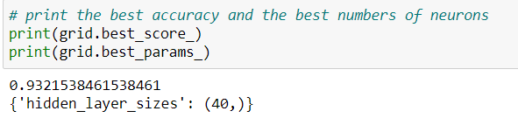
ANN(Scikit-Learn library)
In the first screenshot on the right, With Scikit-Learn library, we define the MLPClassifier to build our ANN model. Moreover, we apply gridsearch to find the best parameter, which is hidde_layer_sizes = 40 in this classifier
Based on the grid search, we got the final accuracy 0.932

Slide 14
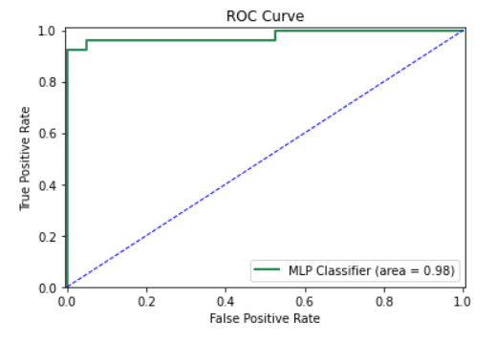
ANN(Scikit-Learn library)(Cont.)

Slide 15
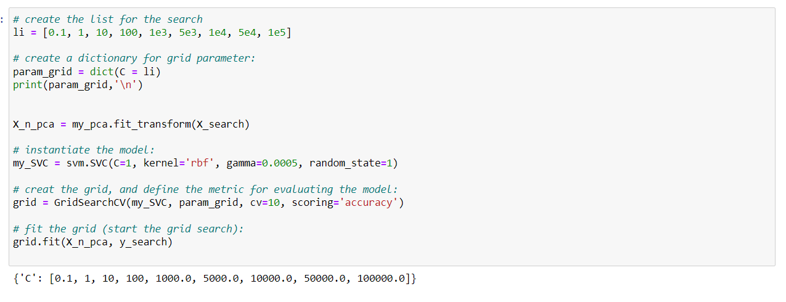
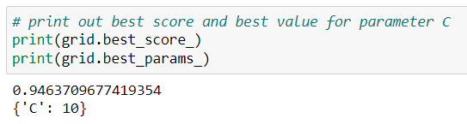
SVM (Support Vector Machine)
We try to use gridsearch again to find the best parameter of C, we define the range list [0.1, 1, 10, 100, 1e3, 5e3, 1e4, 5e4, 1e5], and implement other parameter as the first screenshot shown on the right hand side
Finally, we get an accuray 0.9463 by using the parameter C=10, which we think it’s good enough

Slide 16
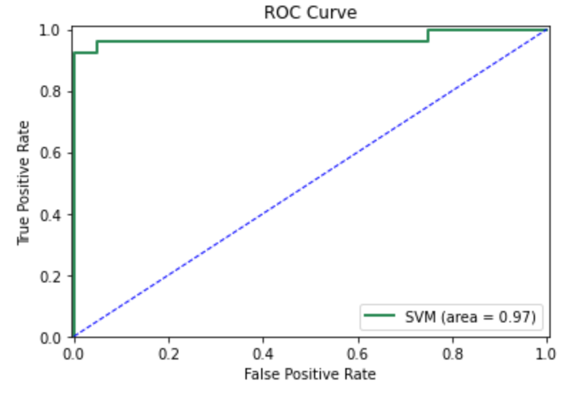
SVM (Support Vector Machine)(Cont.)

Slide 17
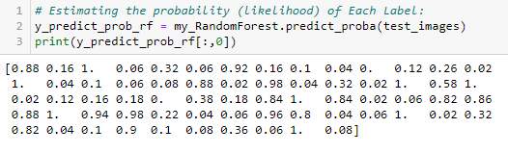
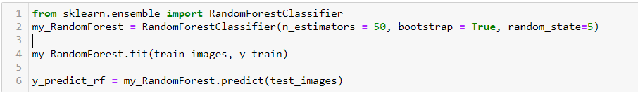

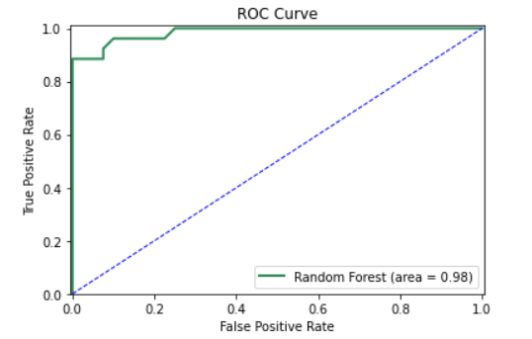
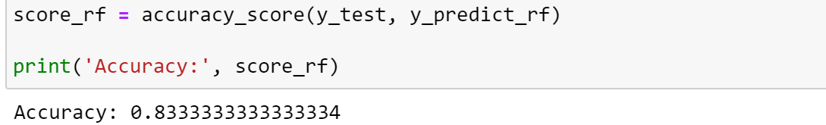
Random Forest & Result
Train the training set and predict the class for testing feature.
The accuracy of classification score is equal to 0.83333333334
Estimate the probability of each label
Find the correct and false positive result, and find the area under curve of the random forest Covid result.
AUC = 0.98

Slide 18
Conclusion & Future Work
CNN accuracy : 0.924
ANN accuracy : 0.932
SVM accuracy: 0.9463
Random Forest accuracy : 0.833
Based on the accuracy outcome, we conclude that Support Vector Machine delivers the best results for our specific classification task.
The algorithms we use, provide us with great visualization and
contributions to improving COVID-19 detection.
We would like to explore other methods/algorithms like:
K Nearest Neighbor
Recurrent Neural Networks (RNNs)
Generative Adversarial Networks (GANs)

Slide 19
Thank you!

